Slide 1

Distributed Denial of Service Attacks
SAHIL WALUNJ
IIT Goa

Slide 2
Presentation Overview
Introduction to DDoS Attacks
Simulating Traffic
Understanding Entropy in Traffic
DDoS Detection Method
Accuracy of DDoS Detection
Simulation Results
Conclusion

Slide 3
Introduction to DDoS Attacks
Overview of DDoS Attacks
Definition: A Distributed Denial of Service (DDoS) attack is a malicious attempt to overwhelm a target, such as a server or network, with a flood of internet traffic, making the service unavailable.
Purpose of Presentation: This presentation will demonstrate how to simulate a DDoS attack and detect it using an entropy-based method.

Slide 4
Simulating Traffic
Generating Network Traffic for DDoS Detection
Concept: We simulate network traffic by sending data packets from different IP addresses. Under normal conditions, traffic is evenly distributed. During a DDoS attack, most traffic originates from a small number of IPs.
Key Function: send_packets() is a function that creates this simulated traffic. It can model both normal traffic and attack traffic by adjusting the distribution of packets across IPs.

Slide 5
Understanding Entropy in Traffic
Using Entropy to Analyze Traffic Patterns
Entropy Concept: Entropy measures the randomness in data. In network traffic, it quantifies the distribution of packets across IPs.
Key Function: compute_entropy() calculates the entropy of the simulated traffic. Low entropy suggests most packets come from a few IPs, indicating a potential DDoS attack.

Slide 6
DDoS Detection Method
Detecting DDoS Attacks Using Entropy
Detection Logic: The function detect_ddos() compares the entropy of incoming traffic to a pre-defined threshold. If the entropy is below the threshold, a DDoS attack is detected.
Threshold Setting: The threshold is determined by analyzing entropy during normal and attack scenarios and setting it to differentiate between the two.

Slide 7
Accuracy of DDoS Detection
Evaluating the Accuracy of DDoS Detection
Accuracy Function: find_accuracy() tests the detection algorithm by running multiple simulations. It compares the detection results against the expected outcomes (normal or attack) to calculate accuracy.
Performance Metric: The accuracy is given as a percentage, indicating how well the algorithm can correctly identify DDoS attacks versus normal traffic.

Slide 8
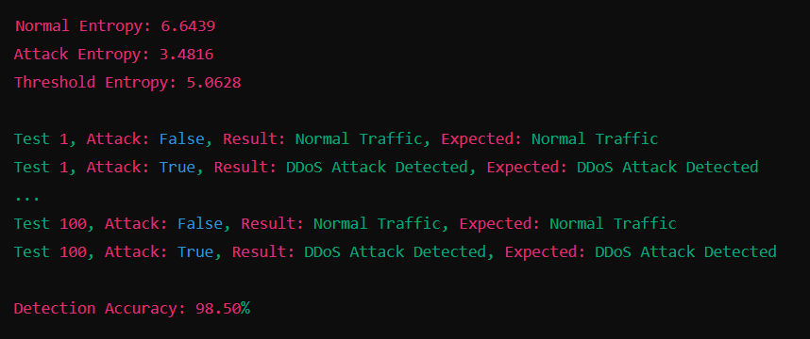
Simulation Results
Results of the DDoS Detection Simulation
Output Analysis: The simulation calculates and displays entropy for both normal and attack traffic. It also determines the detection threshold and evaluates the overall accuracy of the method.
Key Takeaway: The results highlight the effectiveness of entropy as a tool for
distinguishing
between normal traffic
and DDoS attacks.

Slide 9
Conclusion
Summary: This presentation demonstrated a method to simulate and detect DDoS attacks using entropy. The accuracy of detection was evaluated through multiple test scenarios.
Final Thoughts: Entropy-based detection can be a powerful tool in identifying DDoS attacks, helping to maintain network security and service availability.

